Slide 1
Getting started with Java
ICTPRG443 Apply Intermediate programming skills in different languages

Slide 2
What we’re covering
What is Java
Java Syntax & Structure
Pakages, Classes & Statements
main() Method
Common Java Concepts

Slide 3

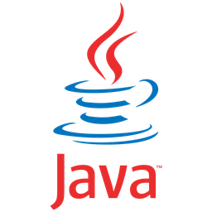
What is Java
A programming language developed by Sun Microsystems in 1993.
A Multi Purpose Object-Oriented Programming Language used to develop web & desktop applications, mobile apps, games and more.
Developed as a Write Once Run Anywhere programming language.

Slide 4


Ide options for Java
IDEs available for Java include:
Eclipse
Netbeans
IntelliJ
BlueJ
JDeveloper
For this class we will be using the IntelliJ.

Slide 5

LETS WRITE OUR FIRST CLASS PROGRAM
Hello World Exercise

Slide 6
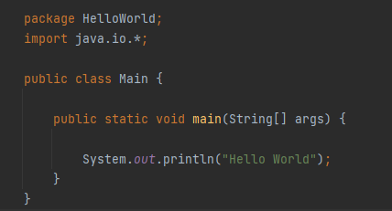
Java code example
Every piece of Java code follows a certain structure and utilizes several common components.
The example shown is a simple console application which prints the words “Hello World” in the command console.

Slide 7
Packages
A Package is a way of collecting and organizing classes and program functionality together.
Every Package will have its own name and can contain a single class file, or it can contain multiple classes and libraries.
Think of it as a file draw or container that holds all your documents.

Slide 8
CLAsses
Classes act like containers that hold collections of data and logic that brings functionality to our programs.
These containers are generally a single file and are generally contained within a Package.
Every class has a name which follows the class declaration. Our example class is called ‘Main’

Slide 9
Import statements
Import statements tells our program to include and install another Package to the application and allow it access and use the classes and functionality of the added Package.
By calling the java.io Namespace in this code example, we can later access the relevant classes and functionality to use later in our code if we need to.

Slide 10
statements
Statements are the lines of code that instruct the program to do something. They can contain various commands or instructions and are always followed by a semi-colon to indicate the end of the statement.
The example given is telling the program to write the words “Hello World” on screen to the output window.

Slide 11
Curly braces
Braces are used to help organize and group together sections of code within your program.
Each set of braces has an opening and closing brace to indicate the start and end of a block or sequence of code.
They help indicate what lines of your code are logically contained within a given Class, Method or other programming structure.

Slide 12
Main Method
This method must always appear in every program and is the starting point for every Java application.
Any code within the main method’s curly braces will be executed in sequence as your application begins.
Depending on the contained code it may create and trigger additional classes and applications as it runs but no program will start without one.

Slide 13
Other useful concepts
Commenting
Whitespace
Case-Sensitivity

Slide 14
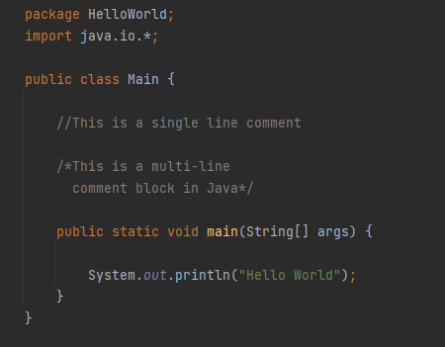
Comments
Comments can be added to your code to give additional information about your program from within your code.
The two most common ways to add comments are:
//Double forward slash for single lines
/*Forward slash followed and asterisk to start a multi-line comment block followed by the reverse to end the block*/
You program will ignore the content in the comment blocks when it runs. This is great for internal code documentation.

Slide 15
White-space
When your application is built and runs, the Java compiler ignores white-space such as empty lines and spaces before and after code blocks and statements.
This can be used to your advantage to give space between sequences of logic to make the code more readable to human eyes.
Use white-space when practical.

Slide 16
Case sensitivity
All names in Java are case sensitive.
“System” and “system” will not be recognized as the same thing.
Take care that when you reference something in your code that the casing matches the object you are referring to.

Slide 17
What we’ve covered so far
What is Java
Java IDEs
Java Syntax & Structure
Packages, Classes & Statements
main() Method
Common Java Concepts - Comments, White-Space & Case-Sensitivity

